Slide 1
Presentation to the Head of purchasing for sweets & candies

Slide 2
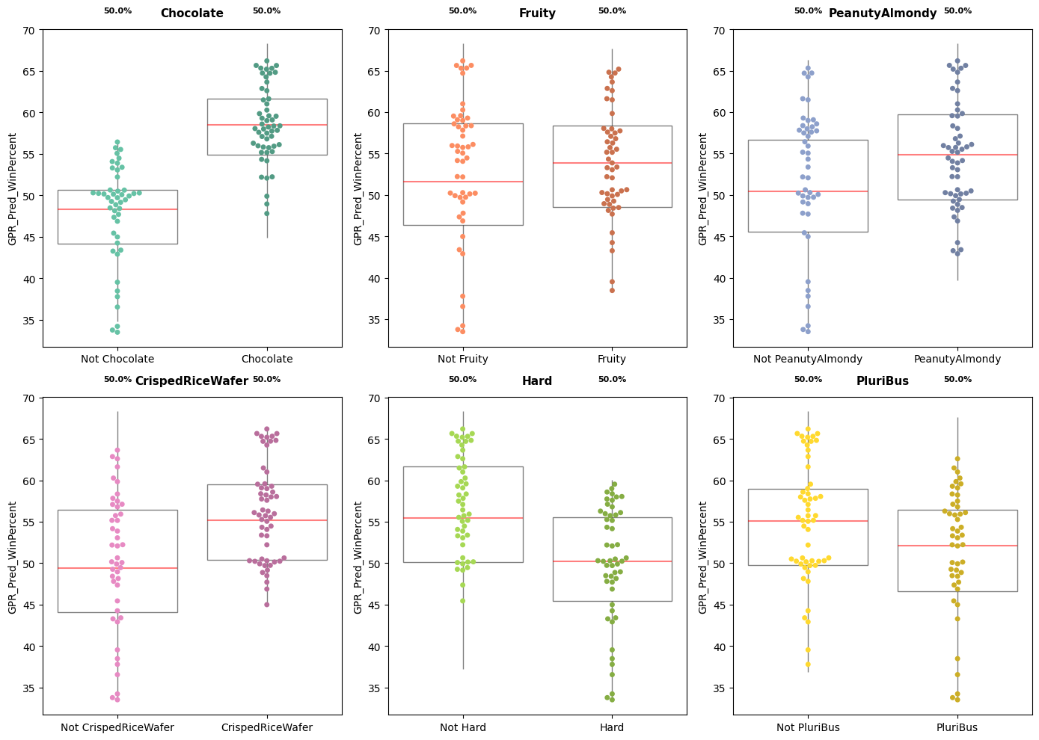

Business Recommendation
Strategy to balance exploration and exploitation for optimal returns
Exploitation - Optimising composition for customer sentiment
Sensitivity analysis shows that the following factors are the strongest individual drivers of higher customer preference–
Chocolate has strongest influence
Not hard candies are preferred
Crisped Rice Wafer and Peanut Almondy.
Chocolate
Crisped Rice Wafer
Optimal choice (safest bet) - considering flavours interdependencies
Customer Preference
Peanut Almondy
Hard
Chocolate
Peanut Almond
Not Hard
Not Pluribus
Not Fruity
Not Crisped Rice
Sugar (max)

Slide 3

Business Recommendation
Balancing Exploration and Exploitation
Exploration – Novel compositions for market differentiation
New Fruity combinations to try
Some flavor combinations haven’t been tested in the market yet, but they look promising based on the strength of their individual effects. These remain higher‑risk options, as the limited data makes their combined performance harder to predict with confidence.
Fruity is an unexplored flavour
Fruity flavours perform well on their own, but they’ve never been paired with some of the other popular flavours
Fruity
Chocolate
(Not hard)
Fruity
Crisped Rice Waf
Fruity
Peanut Almond

Slide 4
Presentation to the Head of Data and AI

Slide 5
Approach
Developed a ML model to predict customer sentiment
Feature Selection
Dataset had some features that were correlated with other features or did not have enough variation.
So Recursive Feature Eliminations was used to select features for modelling.
GPR model with reasonable accuracy
Model | 5 Fold CV (R2) | Train Set (R2) | Test Set (R2)
Baseline (Mean Prediction) | -0.26 | 0 | -0.03
Linear Regression | 0.35 | 0.52 | 0.45
Gaussian Process Regression | 0.34 | 0.56 | 0.48
XG Boost | 0.31 | 0.58 | 0.55
GPR was selected because of its ability to give uncertainties as well. It had 0.73 Rs (spearman correlation) for ranking candies.

Slide 6
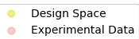
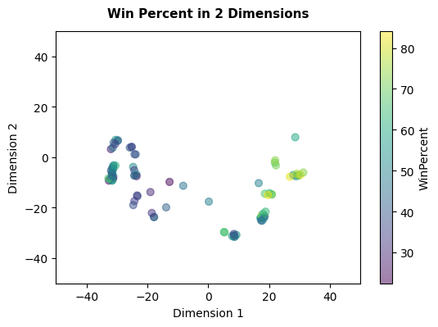
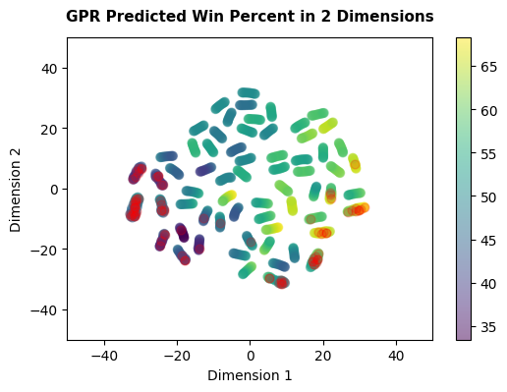
Approach
Sensitivity analysis on design space was used to give recommendations
Experimental Data in reduced 2-D space
Design Space in 2-D with predictions
We used predictions from the design space to understand which features strongly influence how customers perceive different flavours.
The sensitivity analysis helped us identify and quantify each feature’s individual impact by averaging out the effects of all other features. (Helps in answering “cookie-based sweets” or “cookie”? type questions).

Slide 7
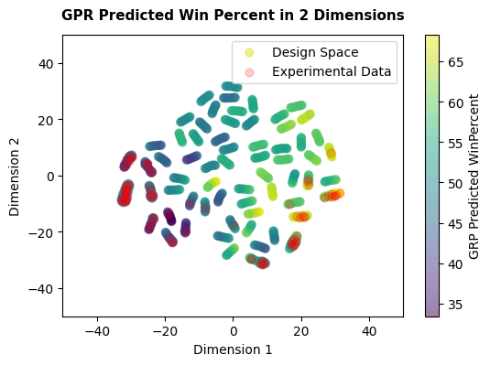
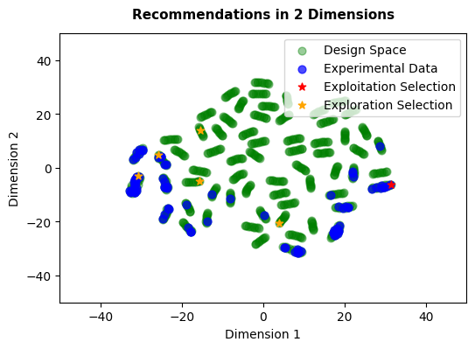
Approach
A set of safe and riskier compositions were recommended
Design Space in 2-D with predictions
Recommendations in 2-D
The design space shows a large set of flavour combinations that remain unexplored. Predictions for these areas carry higher uncertainty, but they also represent potential opportunities for market differentiation.
Fruity, in particular, is significantly under‑explored, so we identified its most promising new combinations for exploration, alongside the best‑predicted composition for immediate exploitation.

